Slide 1
Netflix Recommendation System
Team 1
Praneeth Reddy
Sonali Chaudhari
https://github.com/reddyse/Big-Data-Engineering-Using-Scala.git

Slide 2
Goals Of the Project
With the help of user data and ratings, generate a relevant suggestion based on past available dataset.
Suggesting the movie with highest predicted rating to a particular user.
Meeting the deadline of the project.

Slide 3
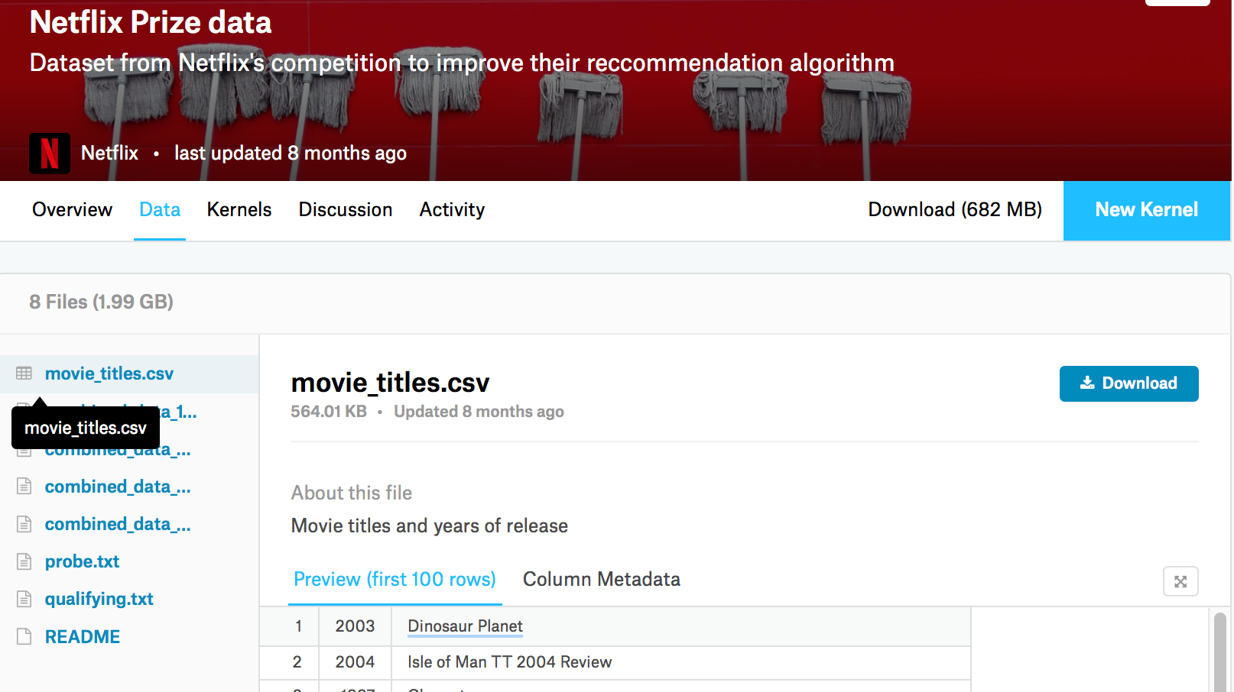
Data Sources
The data source we used was taken from kaggle - https://www.kaggle.com/netflix-inc/netflix-prize-data/data and has about 17770 movie records.
Data Size - 1.99GB
Movie dataset
Training dataset
Qualifying dataset
Probe dataset

Slide 4
Use Case
The rating given by the other users will be used to predict ratings for the movies in qualifying dataset.
The user will be recommended a movie based on the rating prediction(highest rated movie).

Slide 5
Milestone
Key Dates - Using Agile Software Development
Come up with the Prototype and integrate multiple data sources using Apache Kafka | 3/29
Exploring and implementing Play, Actor model and spark and unit tests | 4/15
Integrating Spark and Play | 4/18
Functional and load testing /self acceptance | TBD

Slide 6
Methodology
We will be implementing collaborative recommendation system.
Use Avro for standardization of data
Build an reactive application using Play framework and Actor Model
Use of Spark and Spark Mlib to come up with the recommendations for the user

Slide 8
Scala Programming
Kafka Producers and Consumers
Play
Spark
Spark MLib

Slide 9
Acceptance Criteria
Application should be scalable to handle at least 2500 requests simultaneously.
The model should be scalable to add new data sources as and when required.
Achieve >65% accuracy using probe dataset.

Slide 10
Thank you!

